Slide 1
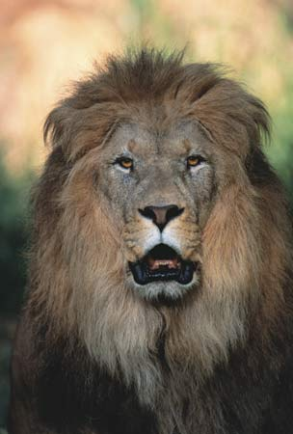
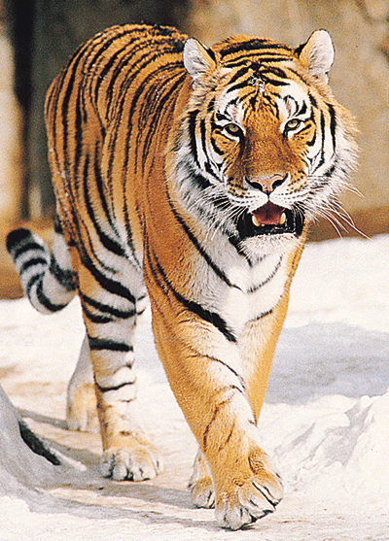
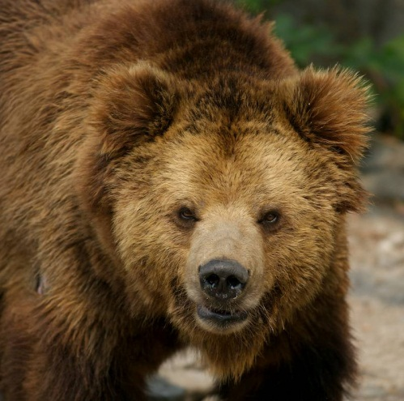
Lions, and Tigers, and Bears! Oh My!
Preparing Foreign Language Teachers for the New-Age Learner
Presented by Martha Hibbard
Spanish Teacher
Conway High East and Bob Courtway Middle School
hibbardm@conwayschools.net

Slide 2
Don’t you recognize these faces?
Is this a Hunter, Billy, or David in your class?

Slide 3
Is this a Susie, Hanna, or Kelsey?

Slide 4
Is this your Juan, Ty, or Jacob?

Slide 6
A Look at the new Aged learner
Media driven
Desire to be entertained
Interested in solving real-world problems
Like doing rather than listening
Digitally savvy
Multitaskers

Slide 7
How do we adapt to their learning styles?
Provide hands-on activities
Use inquiry-based lessons
Allow discovery learning
Allow students to use their technology
Put on a show!

Slide 8
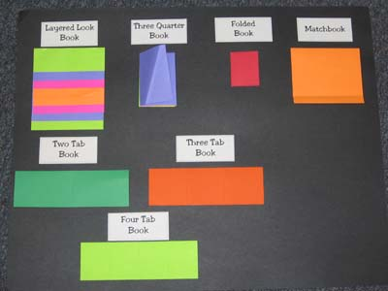
Hands-on Activities
Foldables

Slide 11
Literacy in the Foreign Language Classroom
(You really can do it!)

Slide 12
The Data speaks…

Slide 13
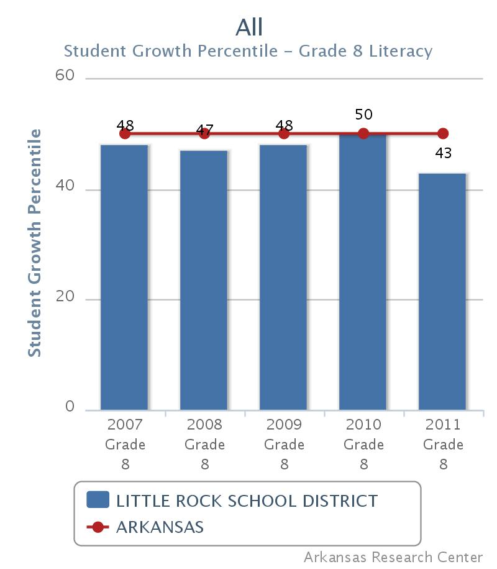

Slide 14
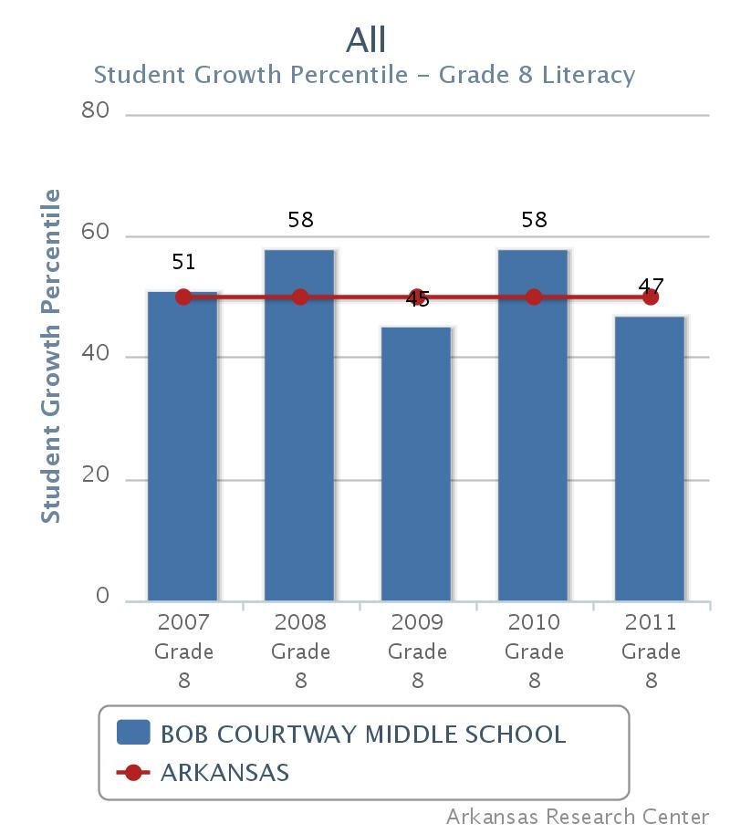

Slide 15
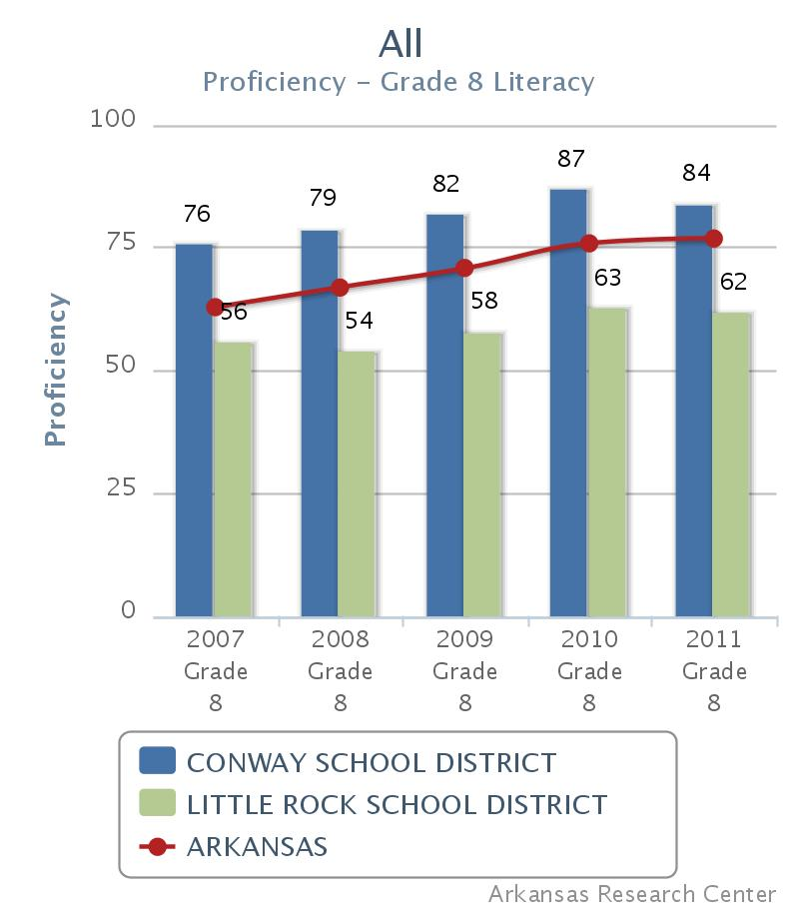

Slide 17
Promoting Literacy
List of Literary Awards by country
Spanish Books:
Pura Belpré Awards
Shadow of a Bull by Maia Wojciechowska (7th -12th)
Once Upon a Quinceañera- Julia Alvarez (9th - 12th)
In the Time of the Butterflies- Julia Alvarez (9th-12th)
http://www.juliaalvarez.com/
http://www.arts.gov/av/avCMS/Alvarez-stream.html
http://neabigread.org/books/timeofthebutterflies/audiotranscript.php
http://neabigread.org/books/timeofthebutterflies/teachersguide01.php
Sun, Stone, and Shadows: 20 Great Mexican Short Stories
http://neabigread.org/books/sunstoneandshadows/teachersguide02.php

Slide 18
Bless Me Ultima- Rudolfo Anaya
http://neabigread.org/books/blessmeultima/teachersguide02.php
Hispanic Heritage Month Booklist
90 Miles to Havana- Enrique Flores-Galbis (7th-12th)
Cuba 15- Nancy Osa (9th-12th)
The Circuit- Francisco Jiménez (6th-12th)
Breaking Through- Francisco Jiménez (6th-12th)
Play ideas from the book
http://www.latinbabybookclub.com/2011_02_01_archive.html

Slide 19
Before We Were Free- Julia Alvarez (9th-12th)
The Tía Lola Stories- Julia Alvarez (5th-9th)
Writing Prompts
The Firefly Letters: A Suffragette’s Journey to Cuba
Margarita Engle (7th-12th)
The Surrender Tree: Poems of Cuba’s Struggle for Freedom- Margarita Engle (7th-12th)
The Poet Slave of Cuba- Margarita Engle (7th-12th)
Esperanza Rising -Pam Muñoz Ryan (7th-9th)
Becoming Naomi León -Pam Muñoz Ryan (7th -9th)
Scholastic Lesson Plan

Slide 20
Reaching Out- Francisco Jiménez (9th-12th)
Canto Familiar- Gary Soto (5th-12th)
Neighborhood Odes- Gary Soto (5th-12th)
A Wedding in Haiti- Julia Alvarez (coming this April)
An Election Essay- Julia Alvarez
A Cafecito Story- Julia Alvarez
http://www.cafealtagracia.com/index.html
When I Was Puerto Rican- Esmeralda Santiago
www.Latinostories.com

Slide 21
French Books:
Words in a French Life: Lessons in Love and Language From the South of France
When in France, Do as the French Do
Paris Peasant- Louis Aragon
Austerlitz-Winfried Georg Sebald
The Kindly Ones- Jonathan Littell
For Freedom: The Story of a French Spy- Kimberly Brubaker
German Books:
Those Crazy Germans! A Lighthearted Guide to Germany

Slide 22
Promoting Literacy Cont’d
Chinese Books:
Mao Dun Literary Awards
Lu Xun Literary Awards
Newman Prize for Chinese Literature
Excursions in Chinese Culture
I Hate English! By Ellen Levine
Where the Mountain Meets the Mooon-Grace Lin
The House That Baba Built: An Artist’s Childhood in China-Ed Young
Amazon searches- young readers chinese
Questions: Open Response-
Reading and Writing for Success- Realidades Textbook

Slide 23
Common core Standards and FL
“Celebrations” – Alonzo Lopez
Family Pictures From “The Fair in Reynosa” - Carmen Lomas Garza
Tomas and the Library Lady- Pat Mora
“Eating While Reading” from Canto Familiar-Gary Soto
The Little Prince- Saint-Exupery, Antoine de.
Where the Mountain Meets the Mooon-Grace Lin
Words Free As Confetti- Pat Mora
Dragonwings- Lawernce Yep
“Eleven”- Sandra Cisneros
“The Book of Questions”- Pablo Neruda

Slide 24
“Oranges”- Gary Soto
Candide, Or The Optimist -De Voltaire, F. A. M.
The Joy Luck Club-Amy Tan
In The Time of the Butterflies- Julia Álvarez
I Am Offering This Poem To You- Jimmy Santiago Baca
Don Quixote- Cervantes
“The Garden of Forking Paths”- Jorge Luis Borges
Dreaming in Cuban- Cristina Garcia
Tartuffe- Jean-Baptiste Poquelin Molière

Slide 25
“A Poem of Changgan”- Li Po
“Ode to My Suit”- Pablo Neruda
“The Latin Deli: An Ars Poetica”- Judith Ortiz Cofer
Tan, Amy. “Mother Tongue”
Anaya, Rudolfo. “Take the Tortillas Out of Your Poetry.”
Pancakes for Breakfast- Tomie DePaola
“Lon Po Po: A Red-Riding Hood Story from China”- Ed Young

Slide 26
Technology in the Foreign Language Classroom
Digital Recorders
Prezi: http://prezi.com/
Documentaries/Movies
Samantha Brown-www.travelchannel.com
Globetrekker- www.pbs.org
Do You Speak American?- pbs.org
Black in Latin America
Haiti & the Dominican Republic
P.O.V.- Point of View Series
Ella Es El Matador
Click the tab “Explore Topics” and Films about “International”
American Documentary Inc.

Slide 27
Technology in the fl Class Cont’d
TikaTok
Blabberize
Weebly- www.marthahibbard.weebly.com
Flip Video Cameras
Flip Tutorial- You Tube Video
My Digital Wish
Flip Powerpoint-Tutorial

Slide 28
Interactive Games and Activities
Minute to Win It
Words with Friends-
Play the other Spanish, French, and/or German classes in a friendly game of words with friends!
Make a huge word board by attaching three long sheets of bulletin board paper.
Draw your letter boxes and assign your Triples and Doubles
Laminate it
Make your letters to choose or draw from
Check out this link to see point/letter distributions
Attach the letters with velcro dots
Enjoy!

Slide 29
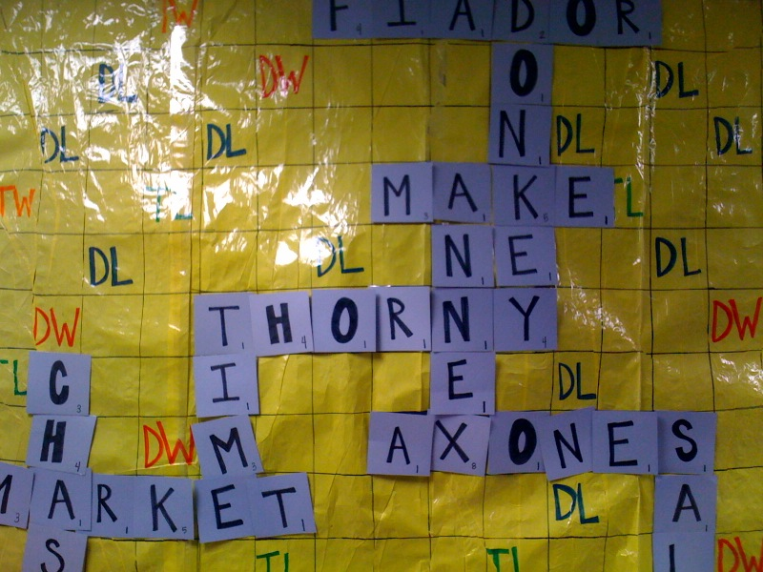

Slide 30
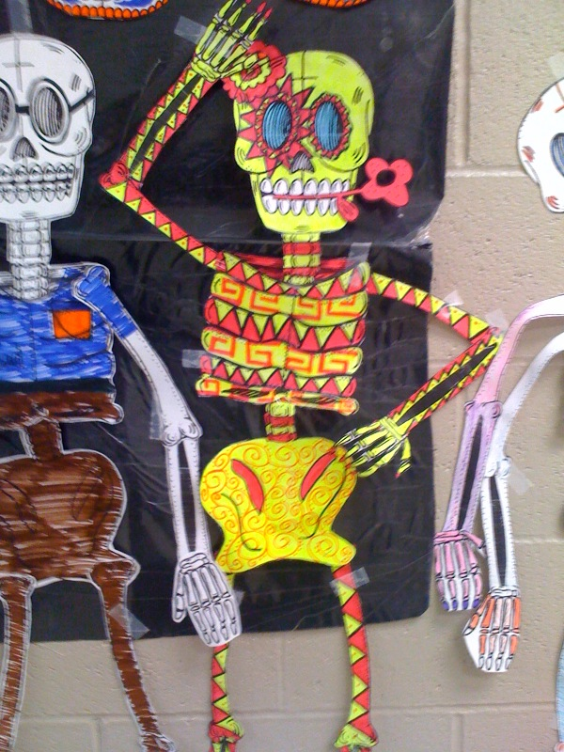
Día de los muertos

Slide 31
Timely Assessments within the FL Classroom
Mobiles
Oral Presentations
Foldables
Gradequick Spreadsheet Checklist

Slide 32
Thank you for
your participation!
Martha Hibbard
hibbardm@conwayschools.net

